Slide 1
WEBPILOT AI AGENT
YOUR AI COPILOT FOR THE WEB
From Instructions to Action – AI that navigates the web for you
TEAM NAME: NOVAMINDS
TEAM MEMBERS :
CHANDRIKA VULAPU-[22491A4240] – Backend Developer
JAGADEESH CHITTIBOINA -[22491A4209] – System Architect
JHANSI YEJARLA-[22491A4243] – Testing & Deployment Engineer
MAHENDRA VARMA CHINTHARABOINA-[22491A5408] – Frontend Developer
BHUMIKA KESANAPALLI-[22491A1218] – AI & NLP Engineer
Notes:
1

Slide 2
Outline
Problem Statement Chosen
Solution Overview
System Architecture
Technology Stack
Algorithms & Models
Data Handling
Implementation Plan
Performance & Validation
Deployment & Scalability
Conclusion
2
Notes:
2

Slide 3
Problem Statement Reference
Problem Statement Chosen :
An AI system that understands natural language commands, autonomously browses real websites, and takes the user directly to the exact product or page they want, eliminating the need for manual searching and clicking.
Reason to Choose the Problem Statement :
We chose this problem because we all face it every day. Finding the right flight, course, or product online isn’t hard it’s just tedious. You spend more time clicking filters and comparing results than actually deciding.
Existing AI assistants only give you links — you still do all the work. Our idea solves this by making the AI do the boring part:
1. It understands what you want,
2. Opens the site, applies filters,
3. And takes you straight to the right and trusted page.
3

Slide 4
Solution Overview
Existing Approach :
Current search engines and AI assistants only give you a list of links or summaries.
You still have to: Open each link manually , Apply filters yourself ,Compare results ,Finally land on the page you need.
This process is slow, repetitive, and frustrating most of the work is still on the user.
Proposed Approach :
Our solution is a WebPilot AI Agent that doesn’t just suggest or summarize — it actually takes action on the internet. The agent understands natural language, plans the task, and then browses real websites like a human to land the user directly on the exact product or page they need, removing the pain of endless clicks and filters , reduces the human efforts and saves the time .
4
Notes:
4

Slide 5
Key Features / Modules
1. Natural Language Command Interpreter :
Understands everyday instructions (e.g., “Book me the cheapest flight from Hyderabad to Bangalore this weekend”)
2. AI Task Planner :
Uses a local LLM to plan the browsing steps
Decides which site to open, what to search, and what filters to apply
3. Autonomous Web Navigator :
Uses Playwright to open websites, apply filters, click buttons
Navigates completely without manual effort
4. Direct Page Landing :
Takes the user directly to the final product or booking page
No extra JSON output or clicking required ready for immediate action
5

Slide 6
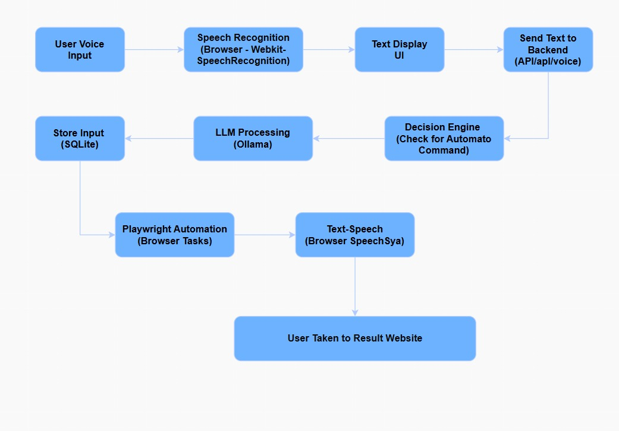
System Architecture
6

Slide 7
Data Flow Explanation
1. User Input : User speaks or types a request into the interface.
2. Speech-to-Text (Browser) : Browser converts spoken words into text using Web Speech API.
3. UI Confirmation : Text is displayed for user review and possible editing.
4. Send to Backend : Final text is sent to the server for processing.
5. Decision Engine : Backend determines the type of action requested using keywords or classifiers.
6. LLM Processing (If Needed) : LLM refines intent and extracts key details for precise automation.
7. Playwright Automation : Automation performs browsing tasks like searching, filtering etc,.
8. Text-to-Speech Response : System verbally confirms the action to the user that I am navigating to that page.
9. User Taken to The Result page : The user is directly shown the exact page they need, without any manual interaction.
7

Slide 8
Technology Stack
Backend & ΑΙ
Flask for coordination and control
Ollama + LangChain for LLM processing
Playwright for web automation
SQLite for local storage
Frontend & APIs
HTML, JavaScript, Tailwind CSS
Web Speech API for voice input
Flask APIs for communication
Text-to-Speech for confirmations
8

Slide 9
Algorithms and Models
1. Algorithms Chosen :
NLU (Ollama + LangChain): Understands natural language commands.
Task Planning: Breaks commands into actionable steps.
Browser Automation (Playwright): Executes tasks on websites like a human.
2. Reason for Choice :
Handles complex, context-based commands and remembers context.
Reliable web automation mimicking user actions.
Ensures end-to-end understanding, planning, and execution.
3. Training & Testing :
Training: Pre-trained Ollama, fine-tuned for task-specific commands.
Testing: Scenario-based tests for intent, step planning, and results; includes edge cases.
Iteration: Refined instructions for higher accuracy and reliability.
9

Slide 10
Data Handling
Data Sources :
Live Websites: Real-time data from e-commerce, flight booking, news portals.
APIs : Structured data from site APIs for faster access.
User Input: Commands (voice) guide the AI’s actions.
2. Preprocessing Methods :
Text Normalization: Converts user input into clean text for the LLM.
Command Parsing: Extracts actionable steps (e.g., site → search → filter → target page).
Dynamic Page Analysis: Detects buttons, input fields, and product listings from live pages.
3. Storage & Pipeline Flow :
Local Storage (SQLite): Stores session data, commands, and context.
Pipeline Steps:
User command → Frontend (voice/text input)
Frontend → Backend (Flask API)
Backend → LLM (understand & plan steps)
Backend → Automation Layer (Playwright) → Execute on live site
Direct navigation → User lands on exact webpage
10

Slide 11
Implementation Plan
1. Initial Setup & Environment
Goal: Prepare all tools and environments for smooth development.
Key Steps:
Install Python, Flask, Playwright, and required libraries.
Set up LLM (Ollama + LangChain) locally.
Configure frontend (HTML, JS, Tailwind CSS).
Test voice input/output (SpeechRecognition & SpeechSynthesis).
2. Core Module Development
Goal: Build main AI agent components.
Modules:
Frontend: Captures voice/text commands, provides feedback, shows progress.
LLM: Understands intent, plans steps, maintains context.
Automation (Playwright): Executes steps on live websites like a human.
Backend (Flask): Connects modules, orchestrates data flow.
11

Slide 12
3. Integration & Testing
Goal: Ensure seamless operation of all modules.
Key Steps:
Connect frontend → backend → LLM → automation.
Test real-life commands (e.g., product searches).
Handle edge cases: ambiguous commands, dynamic sites, network delays.
Fine-tune error handling, retries, and memory.
4.Final Deployment-ready Build
Goal: Prepare a fully functional, user-ready system.
Key Steps:
Optimize backend and automation scripts.
Ensure responsive frontend and smooth voice interaction.
Package for local execution without external servers.
End-to-end testing: AI lands user directly on target page/product.

Slide 13
Performance & Validation
Evolution Metrics (Planned):
Task Completion Rate Percentage of times Al lands on exact requested page.
Command Understanding Accuracy of Interpreting user commands.
Navigation Efficiency Fewer steps and faster results.
Error Recovery - Ability to retry if a page falls.
Response Time How quickly results are delivered.
Testing Strategy :
Functional & Contextual Testing with sample user commands.
Edge Case Testing for slow pages & ambiguous inputs.
User Feedback to improve experience and reliability

Slide 14
Deployment & Scalability
Current Setup :
Right now, everything runs locally on the user’s computer.
The system includes the Flask backend, Ollama LLM, Playwright scripts, and UI — all packaged together.
Users just open it, speak commands, and the AI navigates to the correct live webpage automatically.
Future Deployment Plans :
Server Hosting – Put the system online so multiple users can access it from anywhere.
Standalone App – Make it a simple installable app (.exe/.app) for one-click use.
Cloud Option – Run the AI model in the cloud if local computers don’t have enough power.
Scalability for Growth :
Easily add support for new websites with extra automation scripts.
Handle longer, smarter commands using improved memory and planning.
Multi-user support for teams when hosted on a server.

Slide 15
Conclusion
Our project bridges the gap between natural user commands and real-time web actions. By combining advanced language understanding (LLM + LangChain) with intelligent browser automation (Playwright), the system interprets voice or text commands, plans actionable steps, and executes them seamlessly on live websites. It delivers an interactive, efficient, and user-friendly experience, allowing users to find products, information, or services instantly without manual navigation. This approach demonstrates how AI can simplify online interactions, making digital tasks faster, smarter, and more accessible.

Slide 16
THANK YOU
16

